Slide 1

Introducing Classes Part 1 Java - The Complete Reference Herbert Schildt Chapter 6

Slide 2
Outline
Class Fundamentals
The General Form of a Class
A Simple Class
Declaring Objects
A Closer Look at new
Assigning Object Reference Variables
Introducing Methods
Adding a Method That Takes Parameters

Slide 3
Class Fundamentals

Slide 4
Class Fundamentals
A class is that it defines a new data type (user-defined/custom data type).
This new type can be used to create objects of that type.
A class is a template for an object, and an object is an instance of a class.
An object is an instance of a class.
The two words object and instance are often used interchangeably.

Slide 5
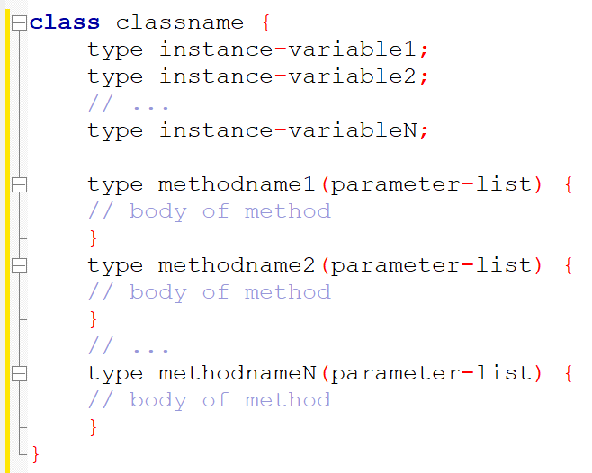
General Form of a Class
A class contains some data and the code that operates on that data.
The data, or variables, defined within a class are called instance variables or fields.
The code is contained within methods.
The variables and methods defined within a class are called members of the class.

Slide 6
General Form of a Class
Instance variables: Each instance of the class (that is, each object of the class) contains its own copy of instance variables.
So, the data for one object is separate and unique from the data for another.
Methods: Methods are similar to function in C/C++. These are actions that are performed when called.
If a class is the starting point for a program, that class must contain a main() method.

Slide 7
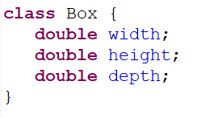
A simple Class
Box class that defines three instance variables: width, height, and depth.
Box is defined as a new data type.
A class declaration only creates a template; it does not create an actual object.

Slide 8


A simple Class
We need to use the new keyword to create a Box object:
mybox1 and mybox2 will be two instances (objects) of Box class.
Both mybox1 and mybox2 contain the instance variables width, height, and depth.
To access these variables, we need to use the dot (.) operator.
The following code snippet assigns 100 to the width instance variable of mybox1 object.

Slide 9
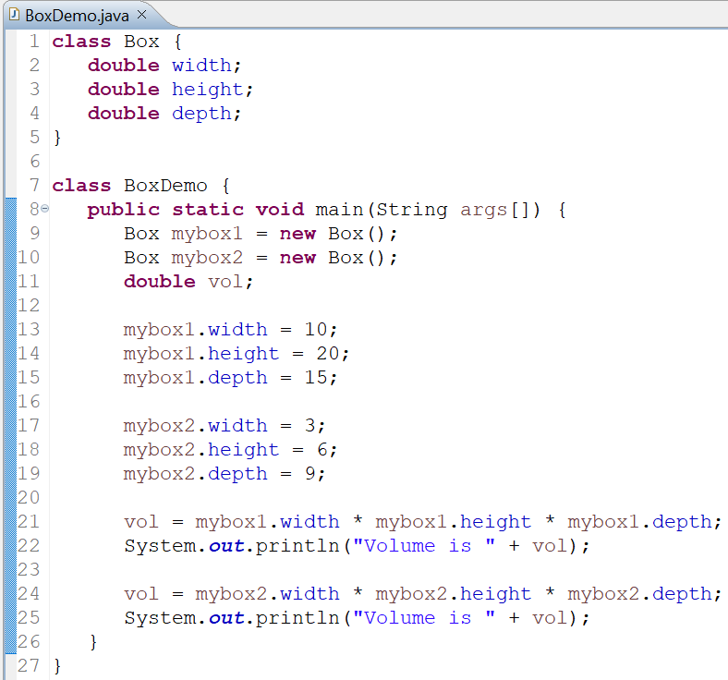
A simple Class: Complete Code

Slide 10
A Simple Class: Class files
The filename must be BoxDemo.java since the class that contains the main() method is named BoxDemo.
After compilation, two class files will be created: Box.class and BoxDemo.class

Slide 11
Declaring Objects

Slide 12


Declaring Objects
Obtaining objects of a class is a two-step process.
A reference (variable) needs to be created. This is not an object.
An object needs to be created and assigned to the reference. We can do this using the new operator.
The new operator dynamically (at run time) allocates memory for an object and returns a reference to it.
This reference is, more or less, the address in memory of the object allocated by new.
In Java, all class objects must be dynamically allocated using the new operator.
References in Java are somewhat similar to pointers in C/C++; however, there are differences.

Slide 13
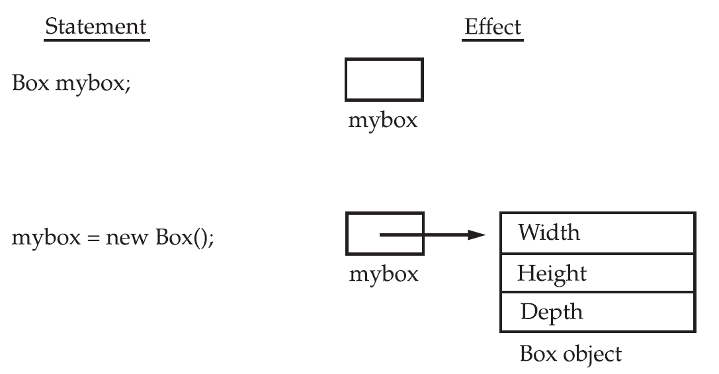
Declaring Objects

Slide 14

A closer look at the new operator
The general form of using new operator for creating objects:
class-var is a variable (reference) of the class type being created.
The classname is the name of the class that is being instantiated.
The class name followed by parentheses specifies the constructor for the class.
A constructor defines what occurs when an object of a class is created.
Most real-world classes explicitly define their own constructors within their class definition.
If no explicit constructor is specified, Java will automatically supply a default constructor.

Slide 15
A closer look at the new operator
Since new allocates memory for an object during run time, a Java program can create as many or as few objects as needed during the execution of the program.
If the whole memory is already allocated, the new operator will fail to allocate memory for an object.
If this happens, a run-time exception will occur.

Slide 16
Class vs Object
A class is a logical construct.
An object has physical reality (an object occupies space in memory).
When we declare an object of a class, we are creating an instance of that class.

Slide 17
Assigning an Object to Reference Variables

Slide 18

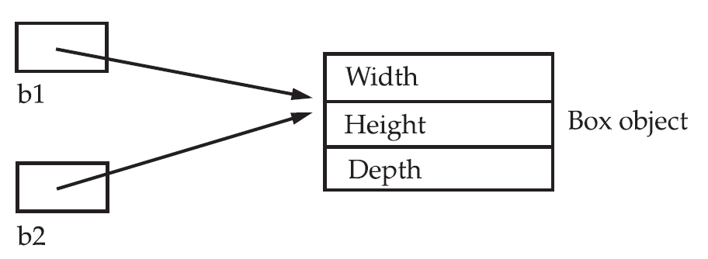

Assigning an Object to Reference Variables
A reference can be assigned another object’s reference.
b1 and b2 will both refer to the same object.
Assignment of b1 to b2 did not allocate any memory or copy any part of the original object.
Any changes made to the object through b2 will affect the object to which b1 is referring.
A subsequent assignment to b1 will simply unhook b1 from the original object without affecting the object or affecting b2.

Slide 19
Methods in Java

Slide 20
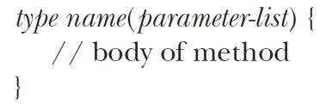
Methods in Java
Classes can contain methods. (Java terminology for functions in C/C++).
General form:
Return type can be any valid type, including class types that you create.
The parameter-list is a sequence of type and identifier pairs separated by commas.
Parameters are essentially variables that receive the value of the arguments passed to the method when it is called.

Slide 21
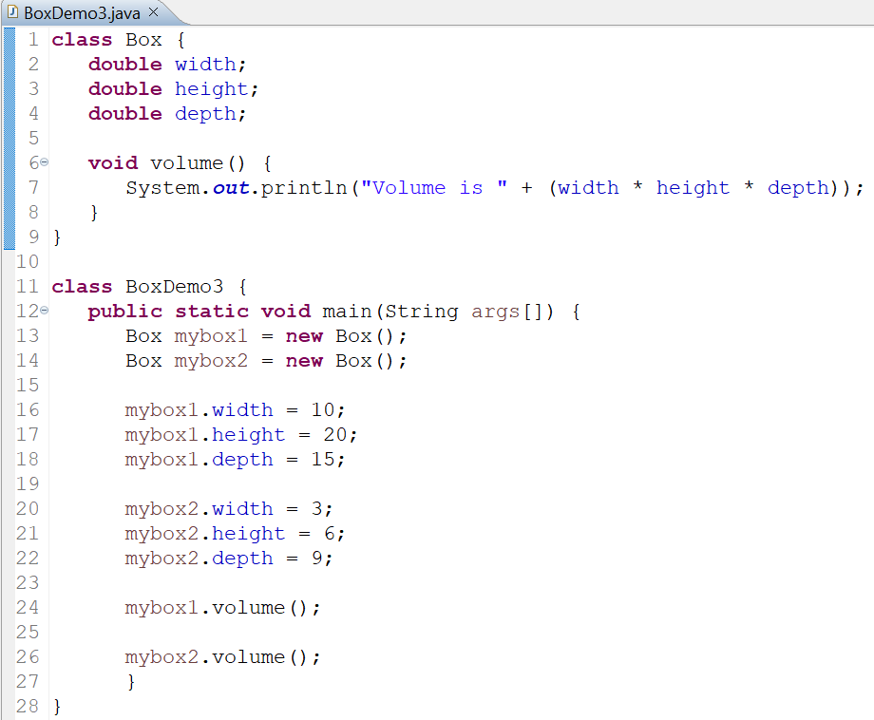
Methods in Java
Inside a method, instance variables are accessed directly without using the dot operator.
Point to remember: A regular method is always invoked relative to some object of its class.

Slide 22

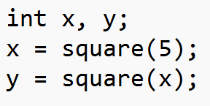
Parameterized Methods
Parameters allow a method to be generalized.
Parameter vs Argument
A parameter is a variable defined by a method that receives a value when the method is called.
An argument is a value that is passed to a method when it is invoked.

Slide 23
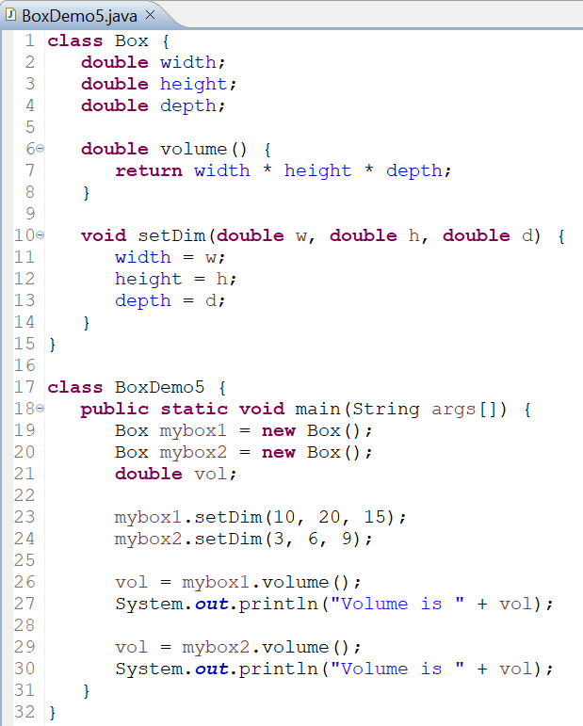

Parameterized Methods: Example
OUTPUT

